Slide 1
Digital Signature Standard (DSS)
Dr. Abhijit Sen

Slide 2
DSS
US Govt approved signature scheme
designed by NIST & NSA in early 90's
published as FIPS-186 in 1991
revised in 1993, 1996 & then 2000
uses the SHA hash algorithm
DSS is the standard, DSA is the algorithm
FIPS 186-2 (2000) includes alternative RSA & elliptic curve signature variants
.

Slide 3
DSS
Digital Signature Standard (DSS) is the digital signature algorithm (DSA) developed by the U.S. National Security Agency (NSA) to generate a digital signature for the authentication of electronic documents.

Slide 4
DSS
DSS has become the United States government standard for authentication of electronic documents. DSS is specified in Federal Information Processing Standard (FIPS) 186.

Slide 5
DSS
DSS provides authentication but not encryption. Therefore, it can only be used for digital signatures-as compared to the RSA system, which can be used for encryption and digital signatures.

Slide 6
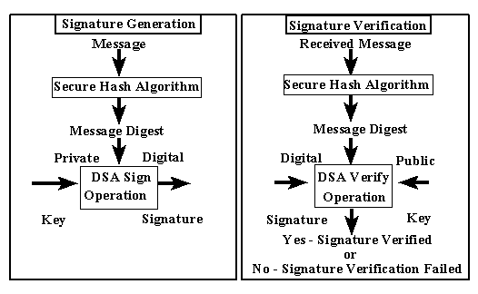
DSS Process

Slide 7


DSS Operation 1
DSS is based on the ElGamal public key system however it is strictly a signature algorithm and is not intended for encryption
  It uses a large number of public/private parameters
  The final verification test is based on the value of r which does not depend on the message
p
q
g
p
g
=
y
F₁
r
r
q
F₄
F₂
F₃
SHA-1
s
s
m
m
k
x
q
SHA-1
verify
m
m
Alice
Bob

Slide 8
DSS Parameters
DSS uses the parameters p, q, g, k, x and y
  Some are private, some public and all have required characteristics:
p: a public 1024 bit prime number
q: a public 160 bit prime factor of p-1
g: a public qth root of 1 mod p
k: a private 160 bit random number
x: a private 160 bit key
y: a public 512 bit key where y = g^{x} mod p

Slide 9
DSS Functions
The four functions in DSS use these 6 parameters and the SHA-1 hash value of the message, h to set up the overall verification process.
  The signature attached to the message consists of the values (r,s) determined by:
  The verification uses (r,s)
  where the message is verified if r = r’
F₁: r = (g^{k} mod p) mod q
F₂: s = k⁻¹(h + xr) mod q
F₃: t = s⁻¹ mod q
F₄: r’ = (g^{ht}y^{rt} mod p) mod q

Slide 10
How it works
As with everything in cryptography, DSS seems like magic but it works because of a mathematical derivation:
Verification equation
(g^{ht}y^{rt} mod p) mod q
= (g^{ht}(g^{x})^{rt} mod p) mod q
y
substitute y = g^{x} mod p
= (g^{(h+xr)t} mod p) mod q
^{(h+xr)}
combine exponents
= (g^{kst} mod p) mod q
note: s = k⁻¹(h + xr) mod q
so: (h + xr) = ks
= (g^{k} mod p) mod q
note: t = s⁻¹ mod q
so: kst = k
= r

Slide 11
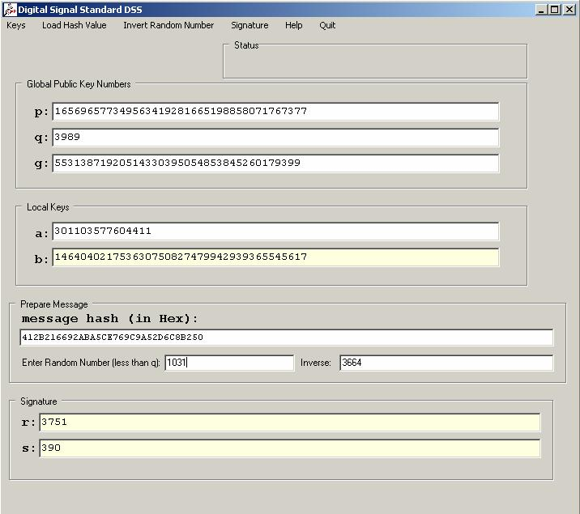
Using CAP
CAP provides access to DSS:

Slide 12
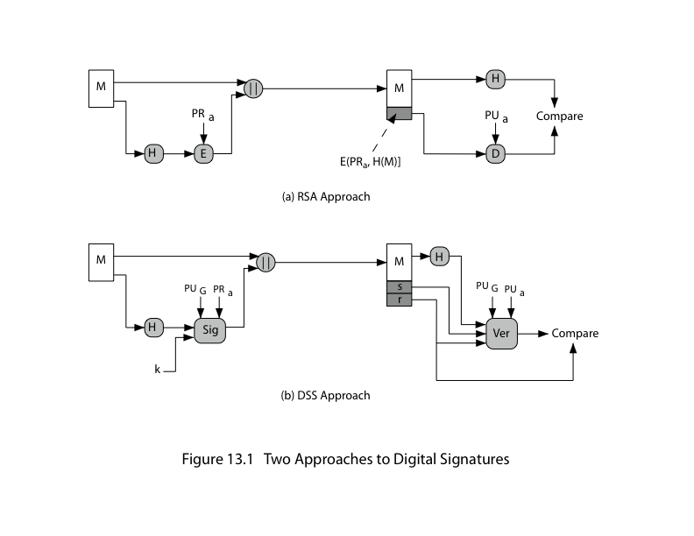
Signatures: RSA VS DSS

Slide 13
DSS: Summary
creates a 320 bit signature
with 512-1024 bit security
smaller and faster than RSA
a digital signature scheme only
security depends on difficulty of computing discrete logarithms
variant of ElGamal & Schnorr schemes

Slide 14
References
DIGITAL SIGNATURE STANDARD (DSS): http://www.itl.nist.gov/fipspubs/fip186.htm
FACT SHEET ON DIGITAL SIGNATURE STANDARD: http://www.nist.gov/public_affairs/releases/digsigst.htm

